Slide 1
Effect of mineral scaling on geothermal wells
Ullas Rajvanshi
Bachelor Thesis Defense

Slide 2
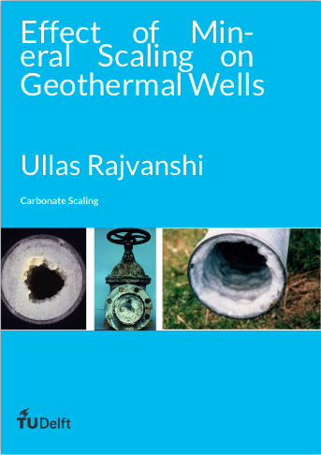
Content
Introduction
Conceptual Model
Hydrogeoch-emical Modelling
Results and Evaluation
Discussion
Conclusion
Available here: https://goo.gl/SUATq1

Slide 3



INTRODUCTION

Slide 4
Source: Drilling the World's Hottest Geothermal Well

Slide 5
Scaling
“Although the output rate of Dieng geothermal power plant [in Indonesia] is 60MW, recently it operates around 42MW. The prime cause of this low output is the stoppage of injection pipe caused by scaling”
Source: Geodipa

Slide 6
TYPES OF SCALING
Carbonate
Silica and Silicates
Sulphates

Slide 7
Carbonate SCALING
Ca²⁺ concentration depends upon
Temperature
Partial Pressure of CO₂
Ionic Strength
Notes:
Calcite deposition is generally a self-scaling process. The main driver for its formation is the loss of CO₂ from the water to the hydrocarbon phase(s) as pressure falls. This removes carbonic acid from the water phase, which had kept the basic calcite dissolved. Calcite solubility also decreases with decreasing temperature (at constant CO₂ partial pressure).

Slide 8
SATURATION INDEX
An index showing whether a water will tend to dissolve or precipitate a particular mineral. Its value is negative when the mineral may be dissolved, positive when it may be precipitated, and zero when the water and mineral are at chemical equilibrium.

Slide 9

PREVENTION
Acting on CO₂ partial pressure
Acting on pH of the solution
Using chemical additives

Slide 10
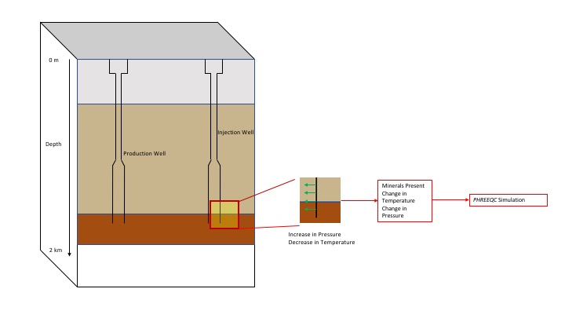
CONCEPTUAL MODEL

Slide 11
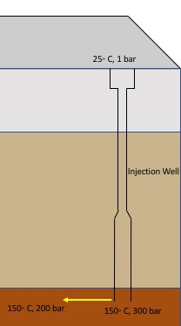

Slide 12
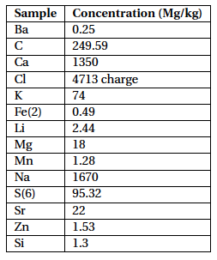
HYDROGEOCHEMICAL MODELLING

Slide 13
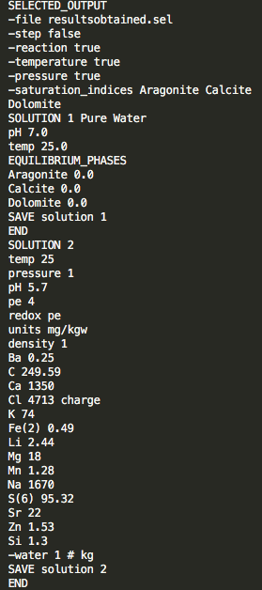
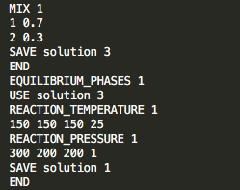
PHREEQC SIMULATION

Slide 14
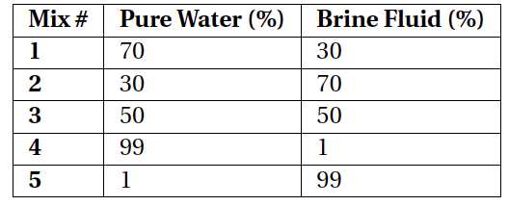
RESULTS

Slide 15
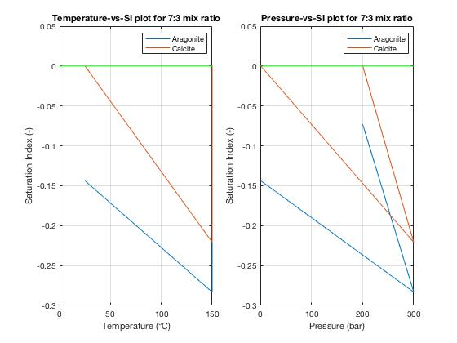
70% pure water 30% brine

Slide 16
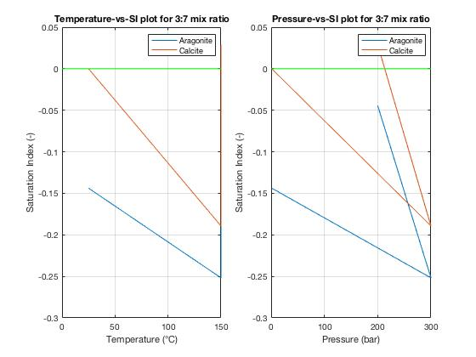
30% pure water 70% brine

Slide 17
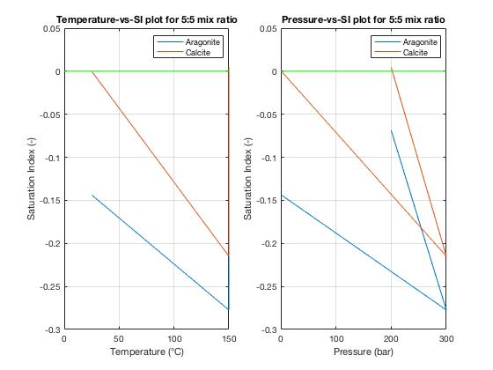
50% pure water 50% brine

Slide 18
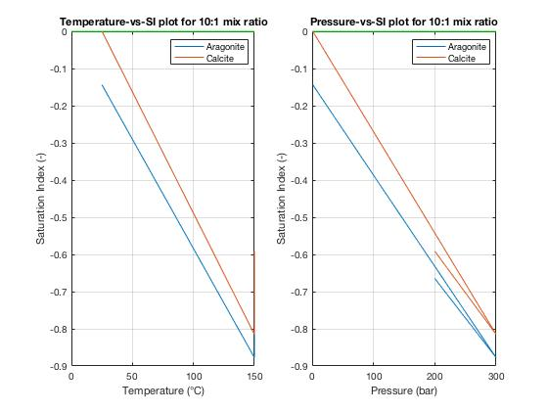
99% pure water 01% brine

Slide 19
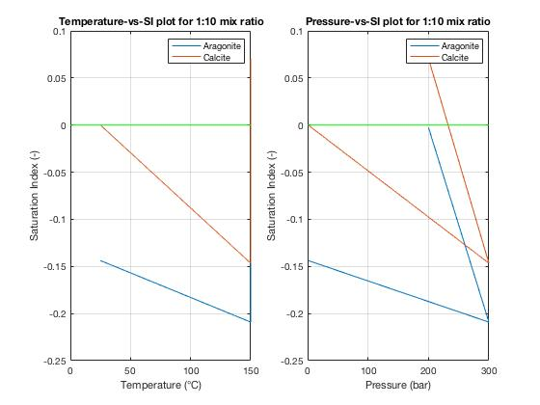
01% pure water 99% brine

Slide 20
DISCUSSIONS
Chemical Composition of the fluid.
Considering scaling in Production Well
Kinetics of the reaction
Other types of scaling

Slide 22
BIBLIOGRAPHY
[1] Kevin L Brown et al. Mineral scaling in geothermal power production. United Nations University, 2013.
[2] Riccardo Corsi. Scaling and corrosion in geothermal equipment: problems and preventive measures.
Geothermics, 15(5-6):839–856, 1986.
[3] EIA. Eia projects 28% increase in world energy use by 2040. 2017. URL https://www.eia.gov/
todayinenergy/detail.php?id=32912.
[4] N. Hilal, H. Al-Zoubi, N.A. Darwish, A.W. Mohamma, and M. Abu Arabi. A comprehensive review of
nanofiltration membranes:treatment, pretreatment, modelling, and atomic force microscopy. Desalination,
170(3):281 – 308, 2004. ISSN 0011-9164. doi: https://doi.org/10.1016/j.desal.2004.01.007. URL
http://www.sciencedirect.com/science/article/pii/S0011916404800328.
[5] "mineral saturation index.". mineral saturation index, 2018. URL https://www.
encyclopedia.com/science/dictionaries-thesauruses-pictures-and-press-releases/
mineral-saturation-index.

Slide 23
[6] Cüneyt Kaya, Gökhan Sert, Nalan Kabay, Mü¸serref Arda, Mithat Yüksel, and Özdemir Egemen. Pretreatment
with nanofiltration (nf ) in seawater desalination—preliminary integrated membrane tests in
urla, turkey. Desalination, 369:10 – 17, 2015. ISSN 0011-9164. doi: https://doi.org/10.1016/j.desal.2015.
04.029. URL http://www.sciencedirect.com/science/article/pii/S0011916415002829.
[7] Petar Papic. Scaling and corrosion potential of selected geothermal waters in Serbia. United Nations
University, 1991.
[8] Kristján Saemundsson et al. Geothermal systems in global perspective. 2013.
[9] V. Stefansson. Global perspective on geothermal energy. 1:11 vol.1–, July 2002. doi: 10.1109/PESS.2002.
1043163.

Slide 24
[10] Barbara Tomaszewska andMagdalena Tyszer. Assessment of the influence of temperature and pressure
on the prediction of the precipitation of minerals during the desalination process. Desalination, 424:
102–109, 2017.
[11] TWVan den Ende. Mineral scaling in geothermal wells. 2012.
[12] Valdemar de Viveiros Pereira et al. Calcium carbonate scaling control in geothermal well pv8 in sao
miguel, azores, combining chemical inhibition and mechanical reaming. 2015.

Slide 25
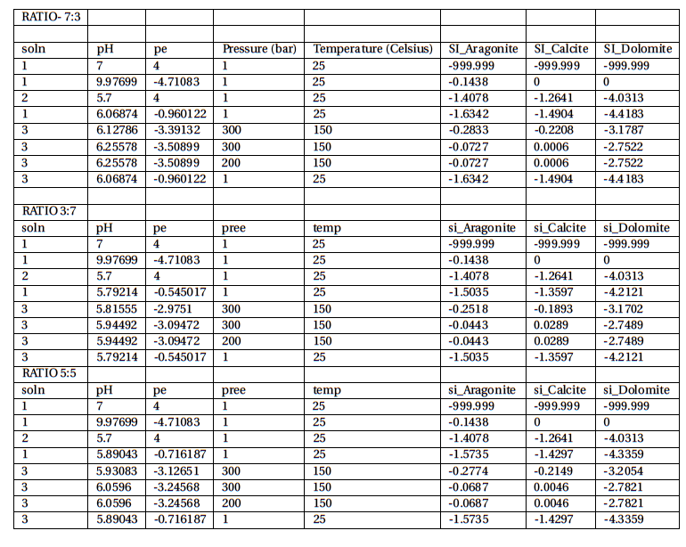

Slide 26
